Slide 1
Importance of Updated
Sector Growth Rates on NONROAD Emissions
Gil Grodzinsky
Georgia EPD - Air Protection Branch

Slide 2
Purpose
Find Ways to Improve on MOVES-NONROAD
Growth Index Based on Data From 1990’s Have Historical Data Now to 2015
Demonstrate Impact of Updating Growth Index on Emissions (and of No Growth)
Suggest Methodology or Support Current Suggestions to Improve Growth Index in MOVES for next Version

Slide 3
Procedure
Ran MOVES-NONROAD for 15 county Atlanta Area (have most updated data from there)
Included 2014 Atlanta Meteorology from Maintenance Plan, Corrected Fuel Blends
Ran 3 scenarios for 2018,2020, 2030, 2040:
  Current MOVES default growth indices
  Altered growth indices based on updated historical and current data
  no growth at all (to parse out other impacts)
Graphed results for each sector and overall

Slide 4
Historical Growth Update: Surrogate Data Sources (Fuel Consumption): US EPA and GA EPD
Equipment Sector | Historical (1996 – 2014) Surrogate Data EPA | Historical (1996 – 2015) Surrogate Data EPD
Construction | EIA Fuel Oil and Kerosene Sales (fuel delivered to commercial consumers) | EIA Georgia No. 2 Diesel Off-Highway Construction
Agriculture | EIA Fuel Oil and Kerosene Sales (fuel delivered to farm consumers) | EIA Georgia No. 2 Diesel Sales/Deliveries to Farm Consumers
Logging | EIA Fuel Oil and Kerosene Sales (fuel delivered to off-highway consumers) | EIA No. 2 Diesel, Fuel Oil and Kerosene Sales (fuel delivered to off-highway consumers)
Oil Field | EIA Fuel Oil and Kerosene Sales (fuel delivered to oil company consumers) | N/A
Rail Maintenance | ORNL Transportation Energy Data Book (revenue ton miles) | ORNL Transportation Energy Data Book (revenue ton miles)
Underground Mining | EIA Fuel Oil and Kerosene Sales (fuel delivered to oil industrial consumers) | N/A
Commercial | See Other Surrogate Sources Table | EIA Georgia No. 2 Diesel Off-Highway

Slide 5
Near-Term Growth Update: Surrogate Data Sources (Fuel Consumption): US EPA and GA EPD
Equipment Sector | Projections (2014 – 2040) Surrogate Data-EPA | Projections (2015 – 2040) Surrogate Data-EPD
Construction | EIA Annual Energy Outlook (LPG, natural gas, distillate) | EIA Georgia No. 2 Diesel Off-Highway Construction through 2015, then extrapolate
Agriculture | EIA Annual Energy Outlook (gasoline, LPG, natural gas, distillate) | EIA Georgia No. 2 Diesel Sales or Deliveries to Farm Consumers through 2015, then extrapolate
Logging | EIA Annual Energy Outlook (gasoline, LPG, natural gas, distillate) | EIA No. 2 Diesel, Fuel Oil and Kerosene Sales through 2015, then extrapolate
Oil Field | EIA Annual Energy Outlook (gasoline, LPG, natural gas, distillate) | N/A
Rail Maintenance | EIA Annual Energy Outlook (revenue ton miles) | ORNL Transportation Energy Data Book, then extrapolate
Underground Mining | EIA Annual Energy Outlook (gasoline, LPG, natural gas, distillate) | N/A
Commercial | See Other Surrogate Sources Table | EIA Georgia No. 2 Diesel Off-Highway through 2015, then extrapolate

Slide 6
Historical Growth Update: Other Surrogate Data Sources: US EPA and GA EPD
Equipment Sector | Historical (1996 – 2014) Surrogate Data-EPA | Historical (1996 –2015) Surrogate Data-EPD
Industrial | Bureau of Economic Analysis (GDP) | Bureau of Economic Analysis (GDP for Diesel, LPG, and CNG)
Lawn and Garden (residential) | U.S. Census Bureau (human population) | Minimal impact, complicated breakdown, defer to EPA
Lawn and Garden (commercial) | U.S. Census Bureau County Business Patterns (number of landscaping establishments) | Minimal impact, complicated breakdown, defer to EPA
Recreational Vehicles | U.S. Census Bureau (human population) | Minimal impact, complicated breakdown, defer to EPA
Commercial | Bureau of Economic Analysis (GDP) | See Fuel Consumption Table
Airport Service | FAA Terminal Area Forecast (number of commercial operations) | ORNL Revenue Cargo Ton-Miles Based Growth Indices
Recreational Marine | Bureau of Economic Analysis (disposable income) | N/A, minimal (defer to EPA)

Slide 7
Near-Term Growth Update: Other Surrogate Data Sources: US EPA and GA EPD
Equipment Sector | Projections (2014-2040) Surrogate Data-EPA | Projections (2015 – 2040) Surrogate Data-EPD
Industrial | Moody’s Analytics (GDP) | Bureau of Economic Analysis (GDP) through 2015, then extrapolate
Lawn and Garden (residential) | U.S. Census Bureau (human population) | Minimal impact, complicated breakdown, defer to EPA
Lawn and Garden (commercial) | Moody’s Analytics (GDP) | Minimal impact, complicated breakdown, defer to EPA
Recreational Vehicles | U.S. Census Bureau (human population) | Minimal impact, complicated breakdown, defer to EPA
Commercial | Moody’s Analytics (GDP) | See Fuel Consumption Table
Airport Service | FAA Terminal Area Forecast (number of commercial operations) | ORNL Revenue Cargo Ton-Miles Based Growth Indices through 2015, then extrapolate
Recreational Marine | EIA Annual Energy Outlook (gasoline, distillate) | N/A, minimal (defer to EPA)

Slide 8
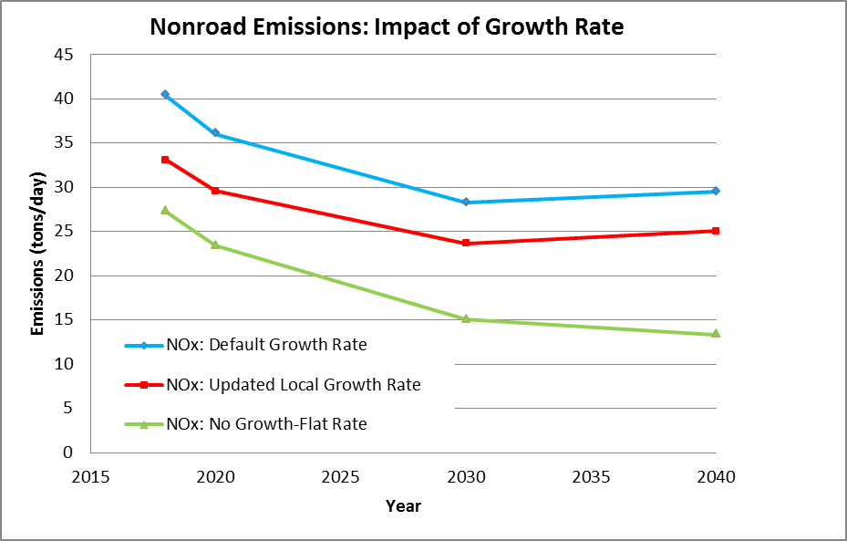
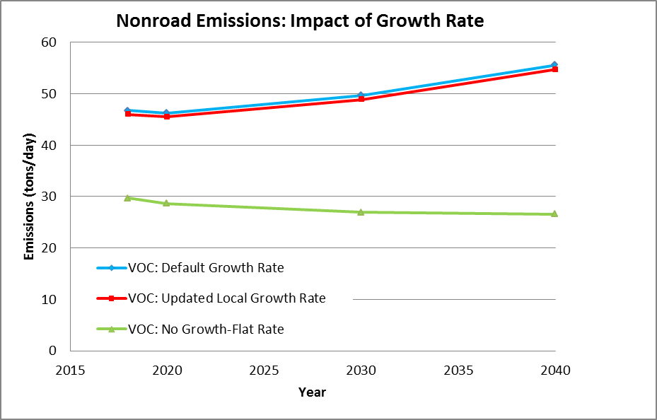
Emission Factors Overall

Slide 9
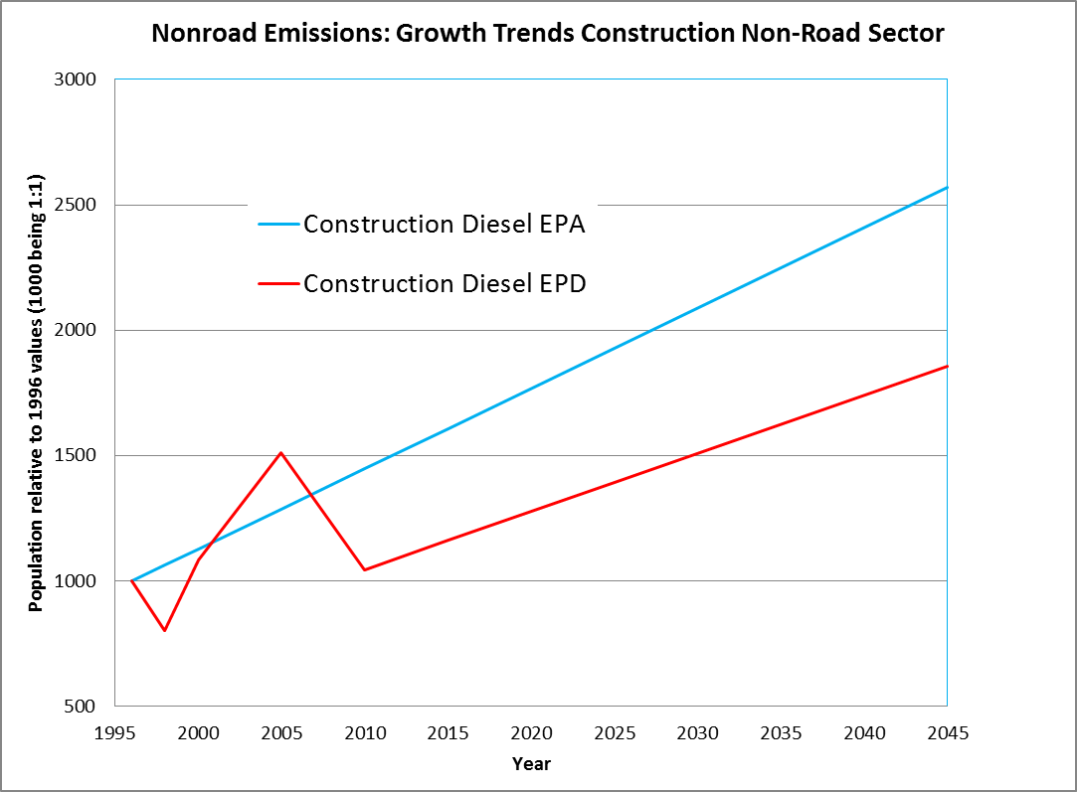
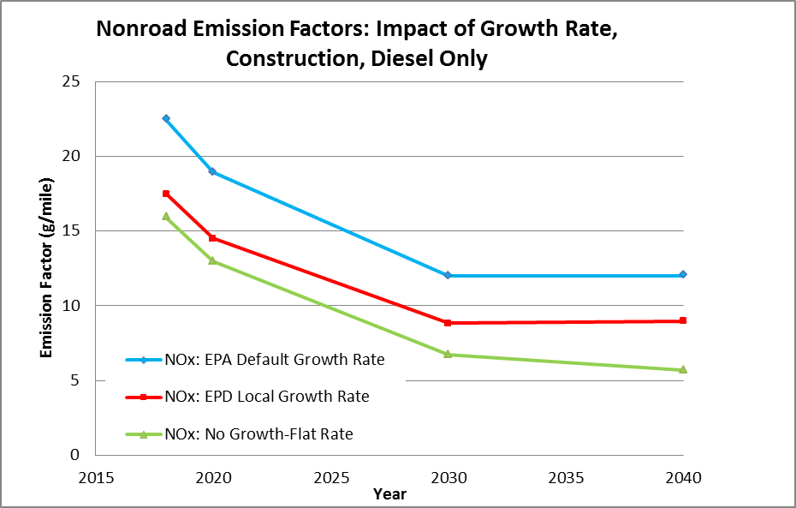
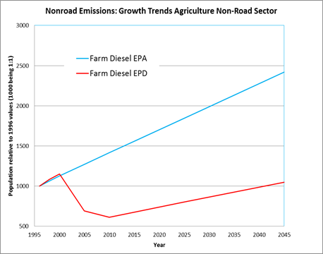
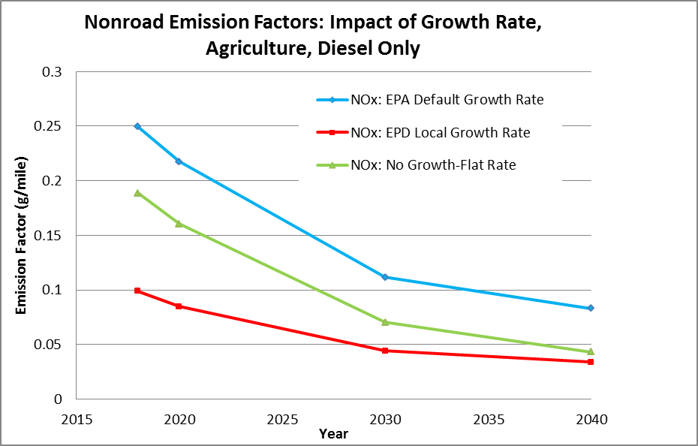
Growth Rate and NOx Emission Factors By Sector

Slide 10

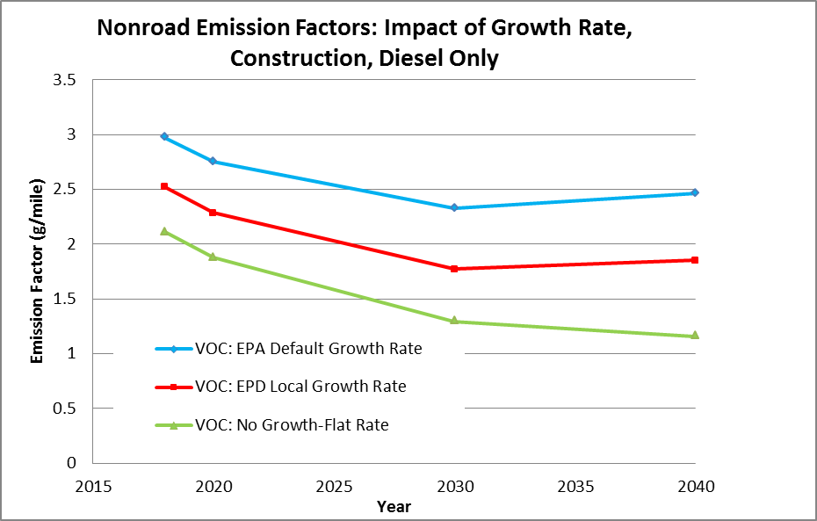
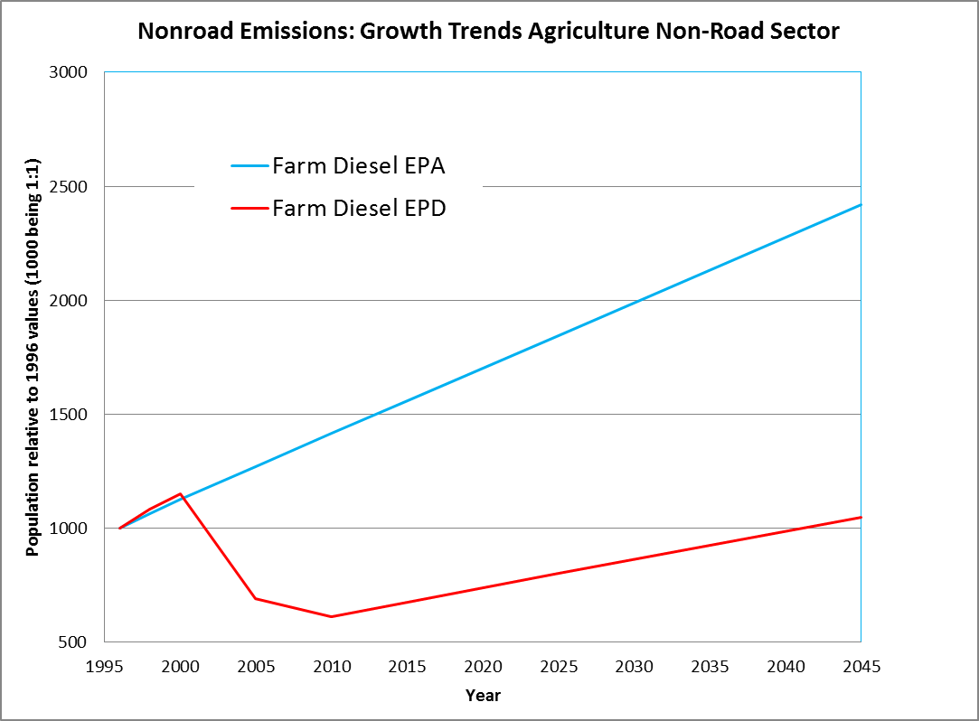
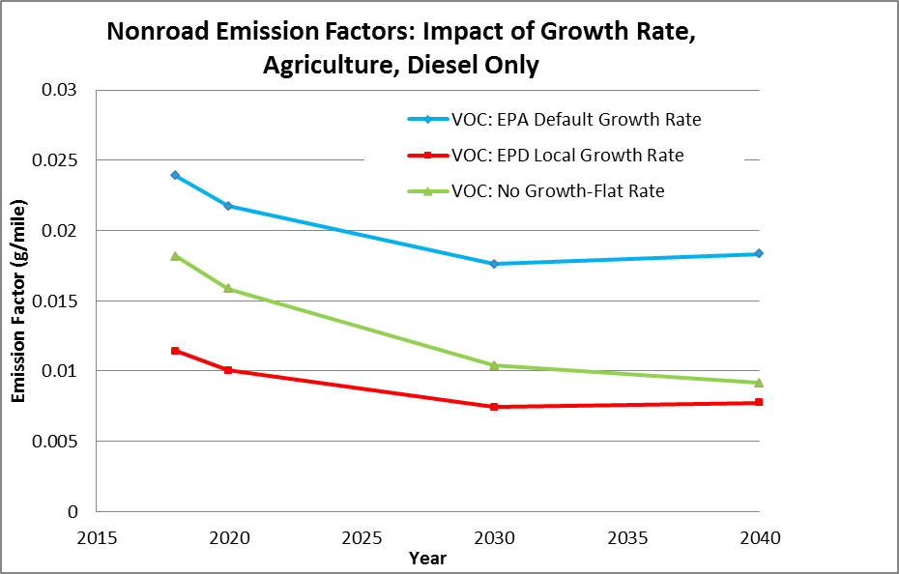
Growth Rate and VOC Emission Factors By Sector

Slide 11
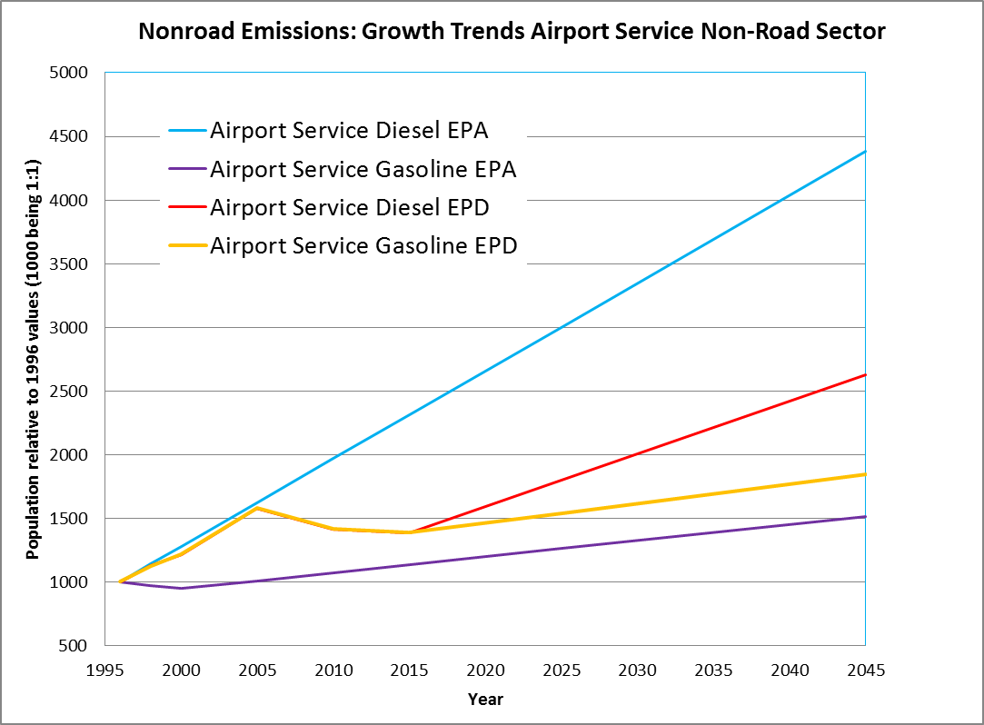
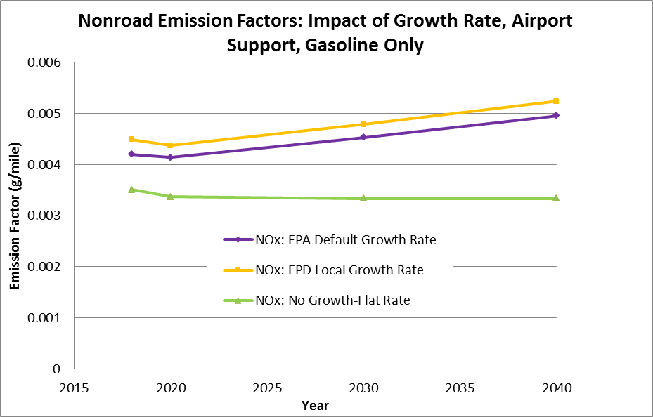
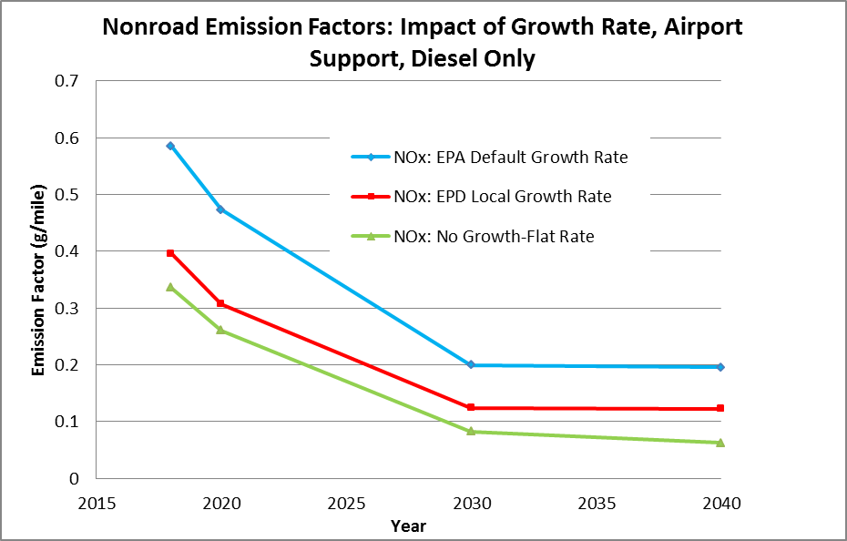
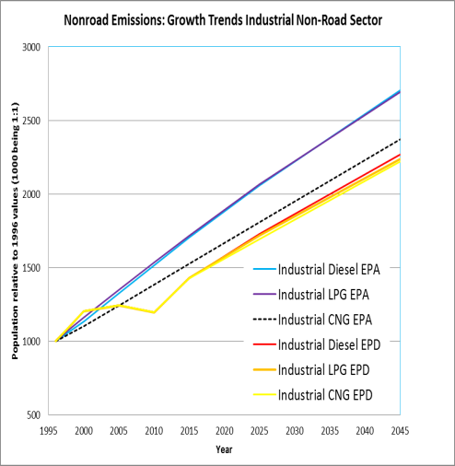
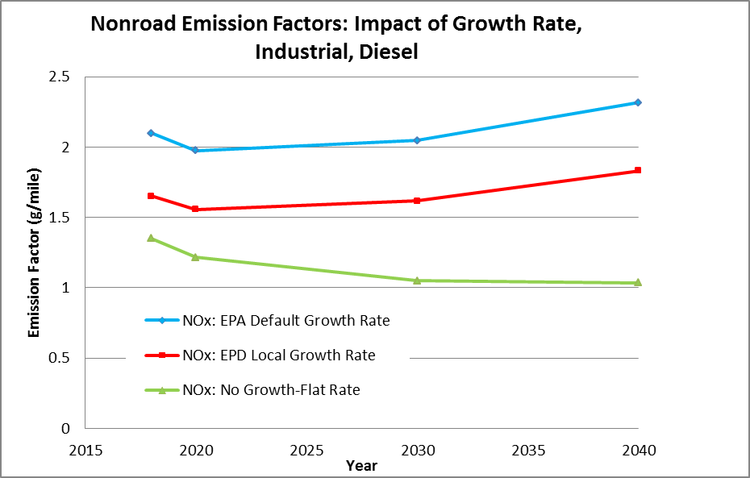
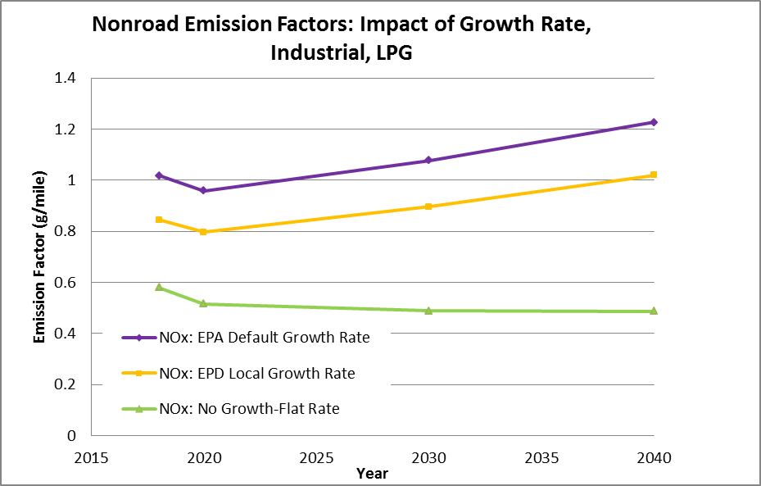
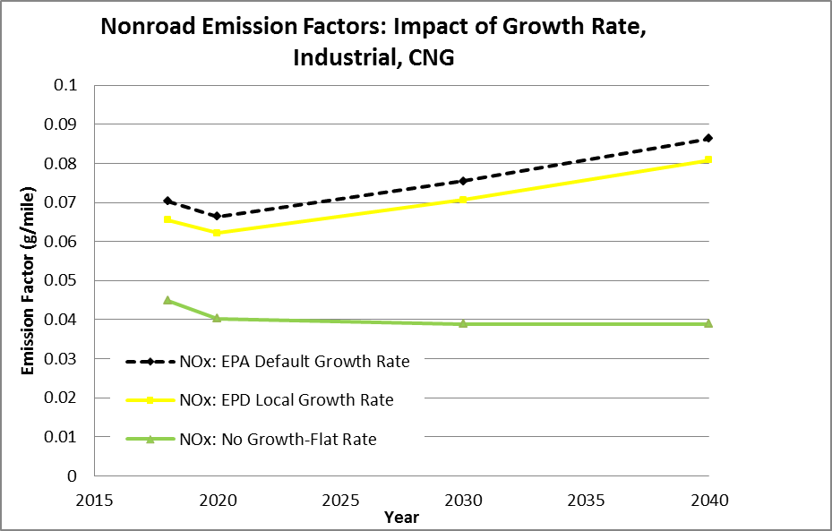
Growth Rate and NOx Emission Factors By Sector

Slide 12

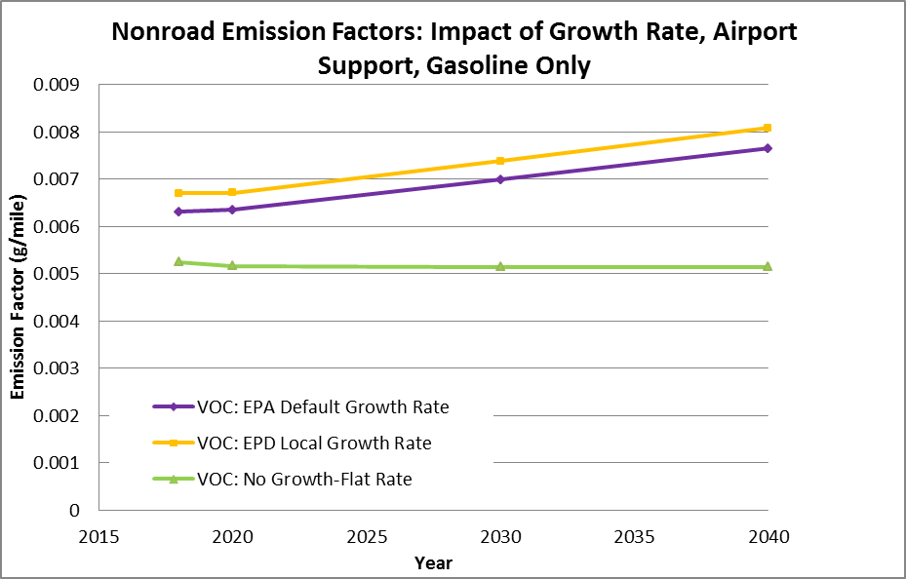
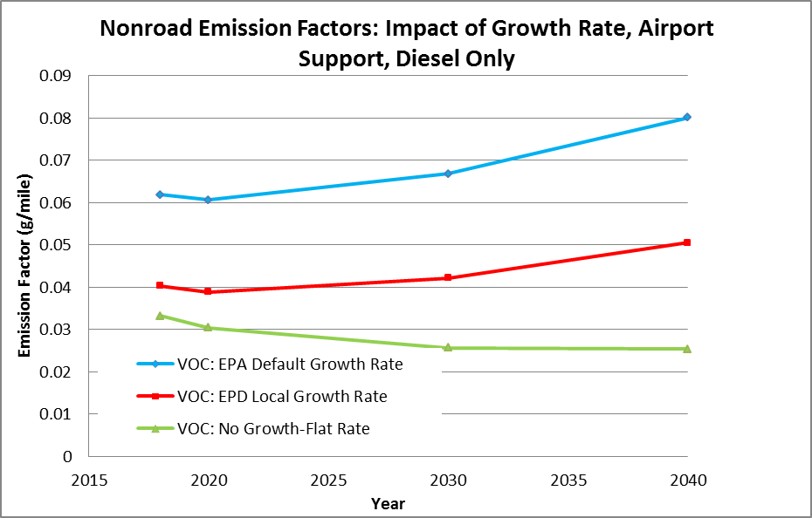

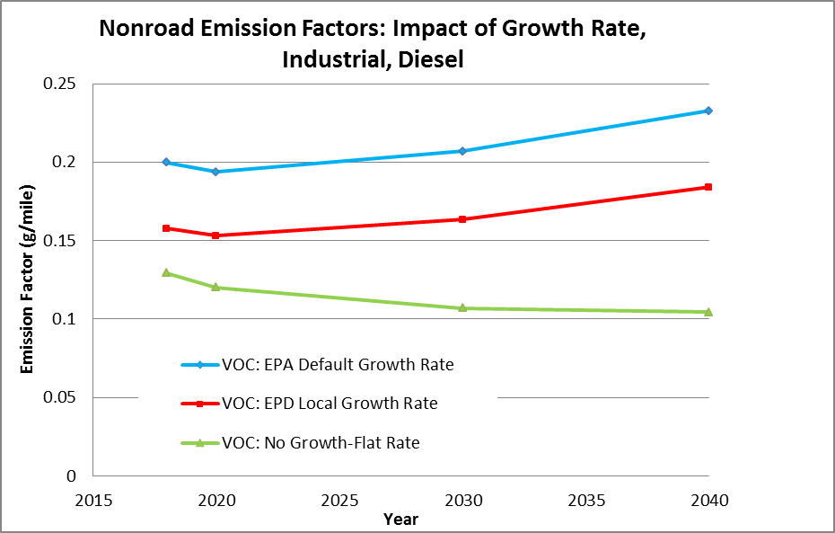
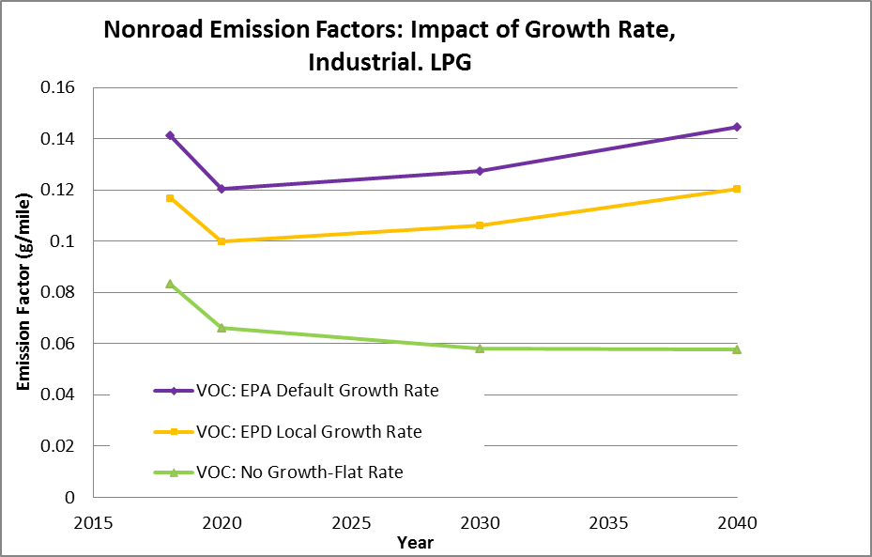
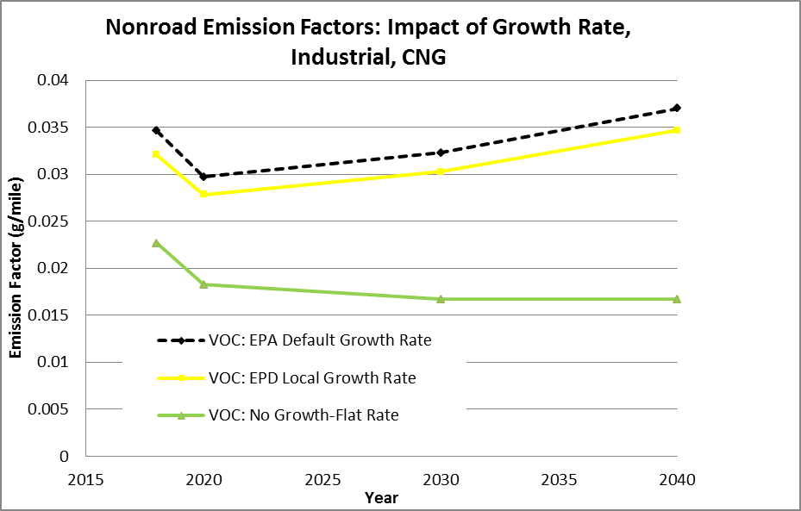
Growth Rate and VOC Emission Factors By Sector

Slide 13
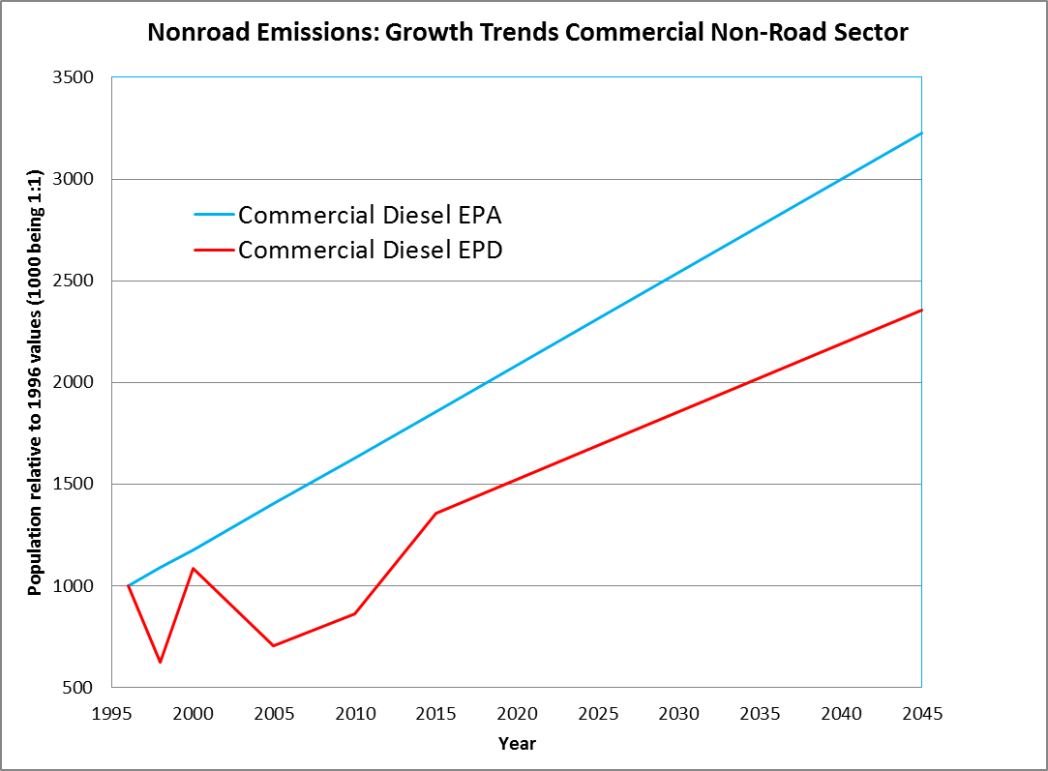
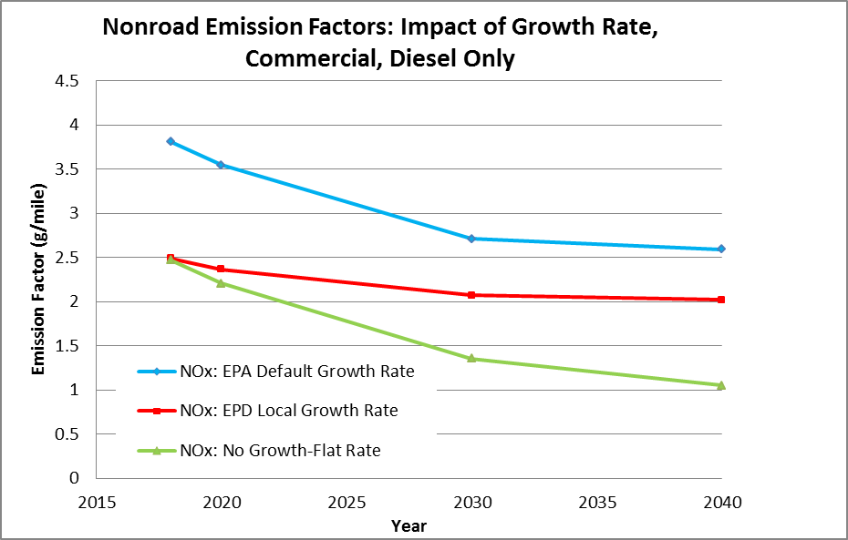
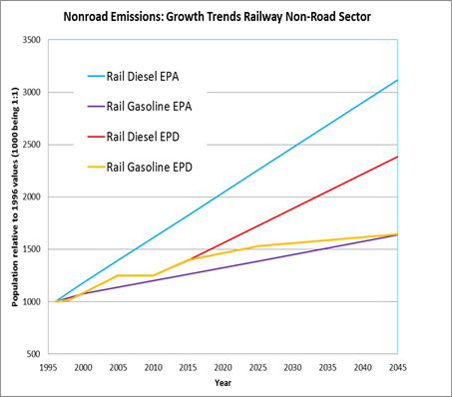
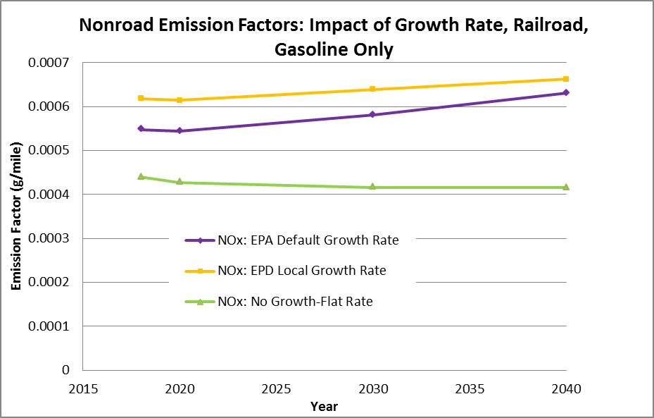
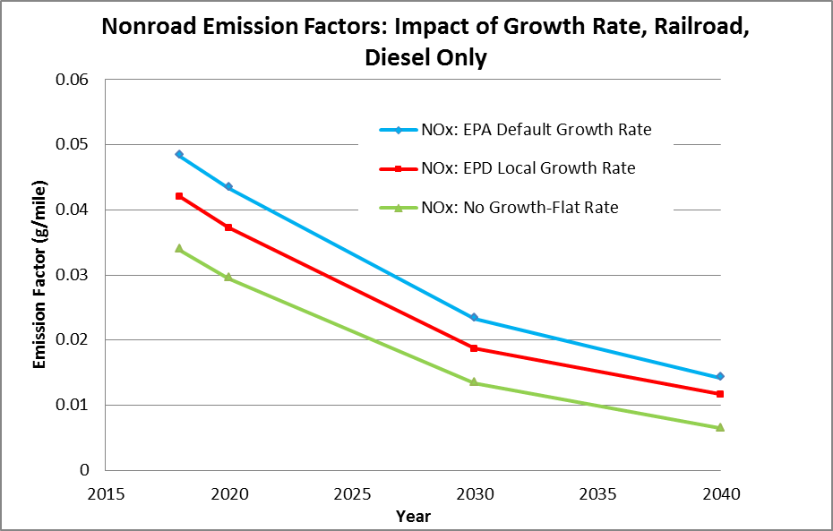
Growth Rate and NOx Emission Factors By Sector(cntd.)

Slide 14
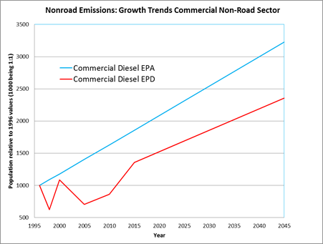
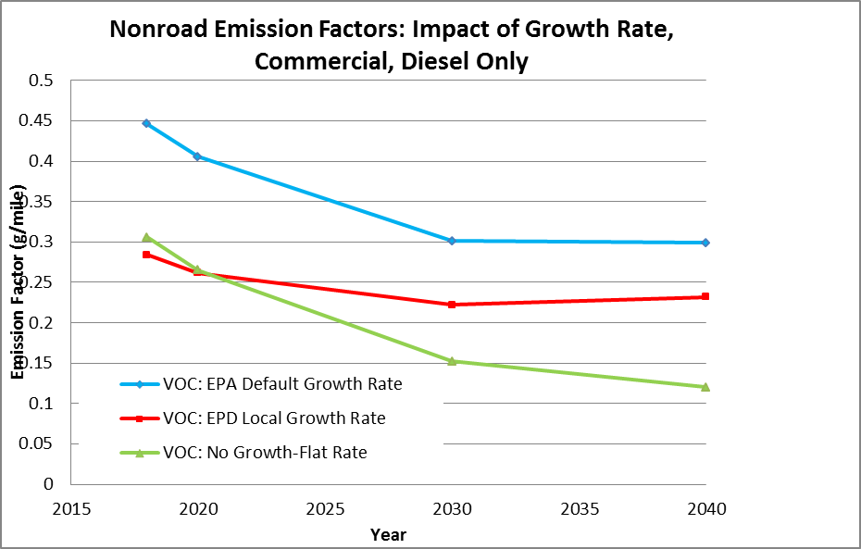

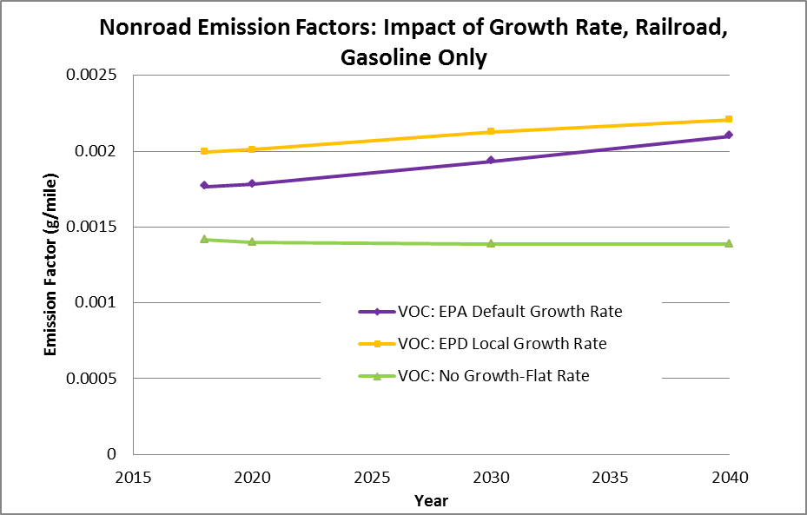
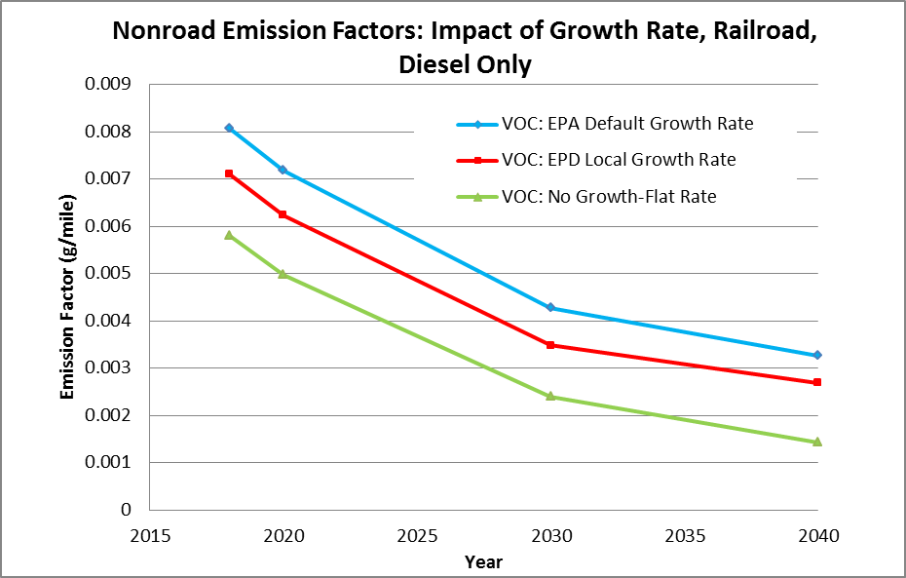
Growth Rate and VOC Emission Factors By Sector(cntd.)

Slide 15
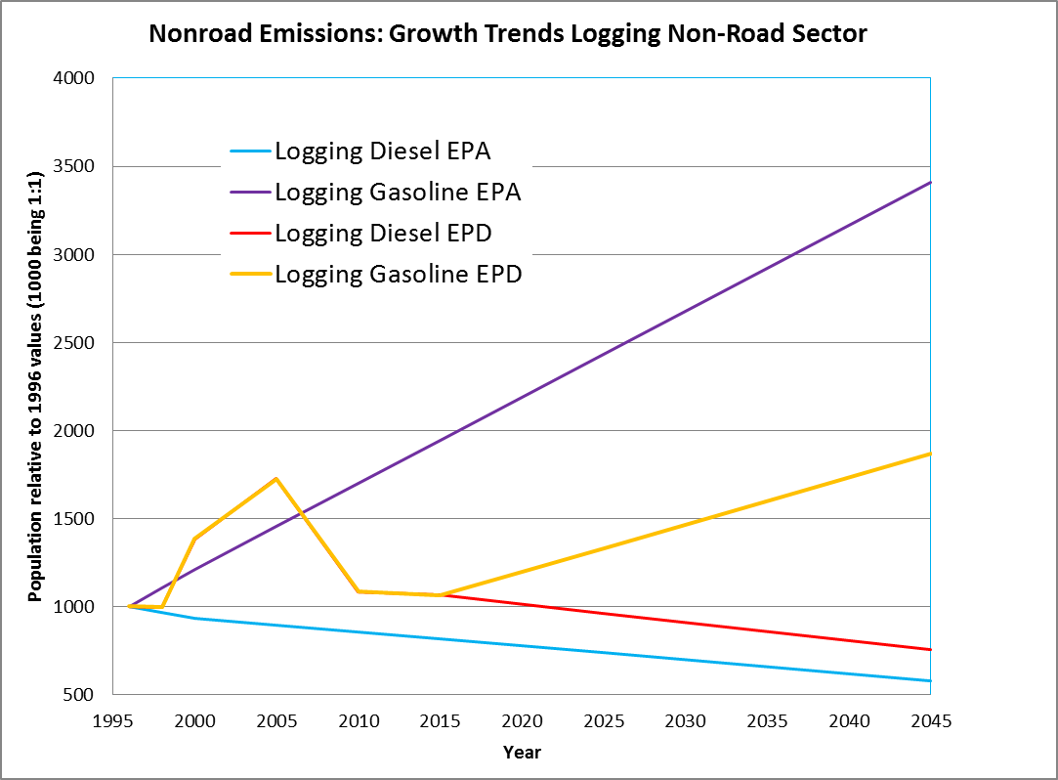
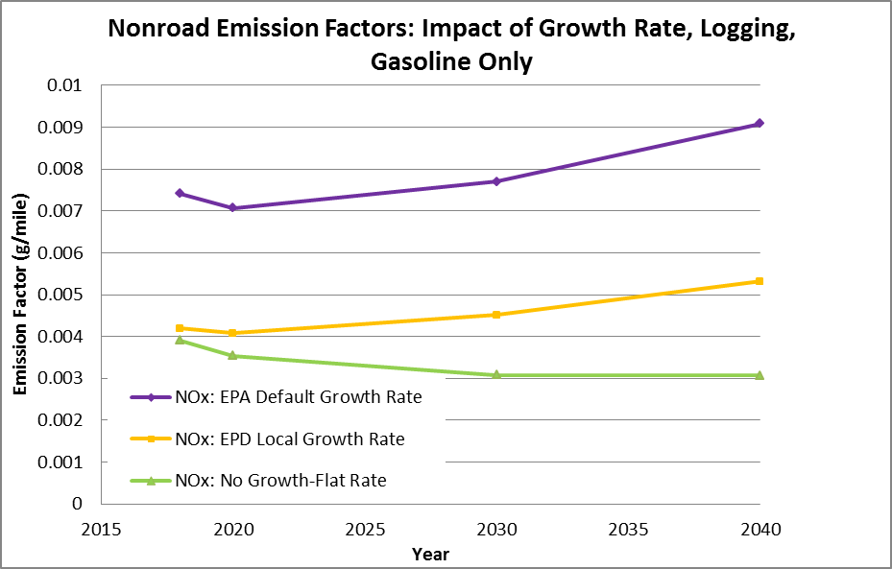
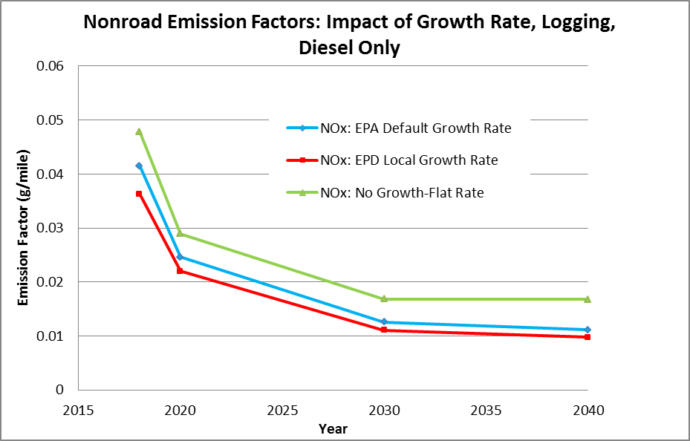
Growth Rate and NOx Emission Factors By Sector(cntd.)

Slide 16

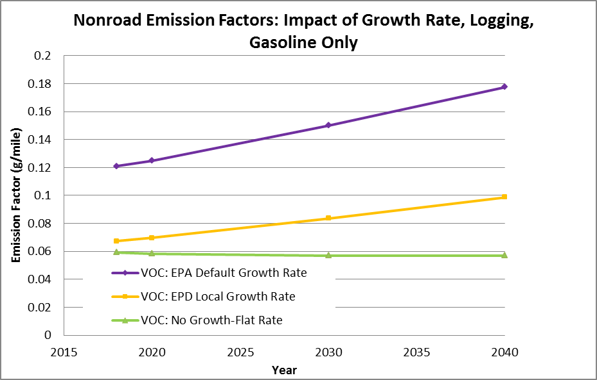
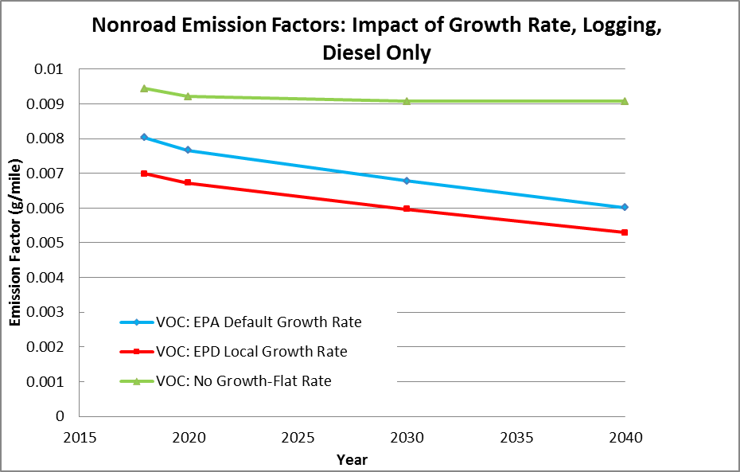
Growth Rate and VOC Emission Factors By Sector(cntd.)

Slide 17
Conclusion/Results- Overall
Total non-road mobile emissions decreased by 15-18% NOx and 1-2% VOC (only slight decrease in impact from 2018 to 2040) replacing updated growth indices, 30-50% decrease (increase in impact over time) versus no growth scenario
Total emissions significantly impacted by growth, especially NOx (Expand study for PM2.5?)
Strong trend downward in no growth case for NOx indicates MOVES-NONROAD takes into account emissions control improvements over time, less VOC

Slide 18
Conclusion/Results-Sector
Emissions by Sector Reflected Population Growth (higher growth, greater emissions)
Going from no growth to default/updated local growth increased NOx and VOC emissions for many individual sector and fuel types by as much as 100-150% (e.g., construction diesel, industrial all fuel types, commercial, airport support all fuels, logging gasoline)
  agriculture/logging diesel saw 30-60% decreases since population decreasing over time
Going from default to updated local growth impacted magnitude of NOx and VOC emissions in various ways, related to individual growth patterns and controls in place
  10% or less for several sector-fuels (e.g., logging diesel, railroad, industrial CNG, air service gasoline), growth trends vary less between default and updated local
  But also up to a 30-60% increase for big Georgia sectors (e.g., commercial, construction, and industrial diesel, LPG) – likely why overall increase of all sectors 30-50% and growth trends varied more between default and updated local
  50% decrease for agriculture due to sharp drop in activity after 2000, not caught by old default data

Slide 19
Conclusion/Results-Sector (cntd.)
Yearly trends reflect the impact of growth vs. emission controls
  If see downward trend in emissions for all growth scenarios, emission controls a big factor, growth data important for magnitude, but less impactful on trend
  If see flat trend with flat growth, and increase with default/updated local growth scenarios (assuming there is growth) then emission controls impact is limited, more sensitive to growth trends)
Trends and controls vary by fuel type, pollutant and sector (e.g., diesel vehicles and NOx emissions seem more controlled)
Growth indices important for accurate emissions levels, and properly identifying future trends, although need to take into account MOVES assumptions on level of controls
Overall impact will depend on state and which sectors dominate

Slide 20
Questions?
Gil Grodzinsky
Georgia EPD - Air Protection Branch
404-363-7123
gil.grodzinsky@dnr.ga.gov

